Slide 1

BOOK RECOMMENDATION SYSTEM
Group -2
TEAM MEMBERS- GROUP 2
Shubhangi Shivaji Arote
Sneha Sanjay Jadhav
Purva Kaiwart
Santosh Reddi
Syed Sarfaraz Pasha
GUIDED BY
Neha Gupta
Deepika p

Slide 2
BOOK RECOMMENDATION SYSTEM
CONTENTS
Data Collection & understanding the dataset.
Data Preparation/Overview
Exploratory Data Analysis
Visualization & Reporting.
Machine Learning model.
Decision Making.
Deployment.

Slide 3
Data Collection & understanding the dataset.
DATA SET DETAILS
No of Datasets – 3
Name of Datasets – Books, User & Ratings.
OBJECTIVE OF THE PROJECT
To generate such features from the data set so that they can be used to recommend the books accordingly to the users.

Slide 4
DETAIL SUMMARY OF DATA (GETTING A BIG PICTURE OF DATA SET)
First 5 data sets
Last 5 data sets
Data Shape
Checking for Data Types – For some of the data sets we have changed their data types.
Checking for null values
Checking for duplicated values
Checking for unique values

Slide 5
Data Preparation/Overview
SN | Observations | Description | Remarks
Book Data Set
1 | Shape | (271360,8)
2 | Null values | There were some null values in “Book Author” & “Publisher” column | Values we interchanged, hence it was rectified & replaced accordingly
3 | Duplicate values | Not such found | -
User Data Set
1 | Shape | (278858, 3)
2 | Null values | Age column has null values of about - 110762 | Null values are filled using mean
3 | Duplicate values | Not such found

Slide 6
Data Preparation/Overview
SN | Observations | Description | Remarks
4 | Outlier | Outlier found in the age column | Hence we have removed the age groups of above 90 & below 5
Ratings Data Set
1 | Shape | (1143780,3)
2 | Null values | Not such found | -
3 | Duplicate values | Not such found | -

Slide 7
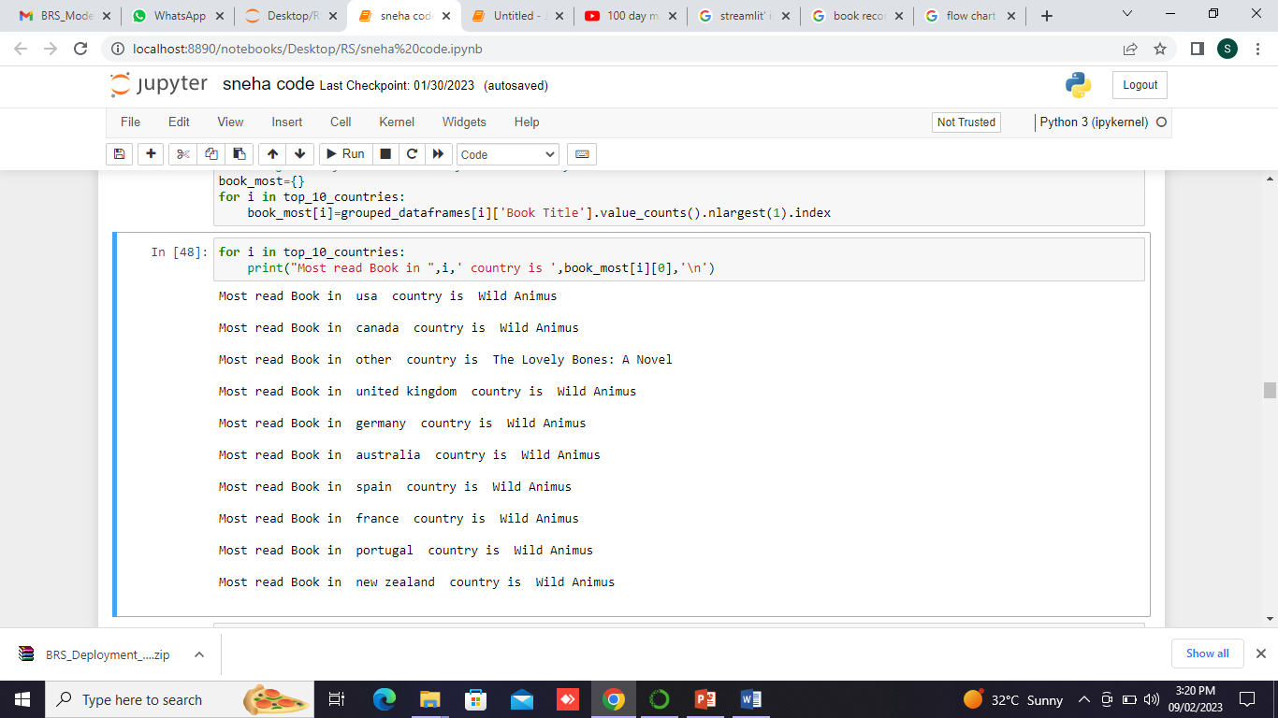
EDA & VISUALIZATION
1. Most Read Books Country Wise.

Slide 8
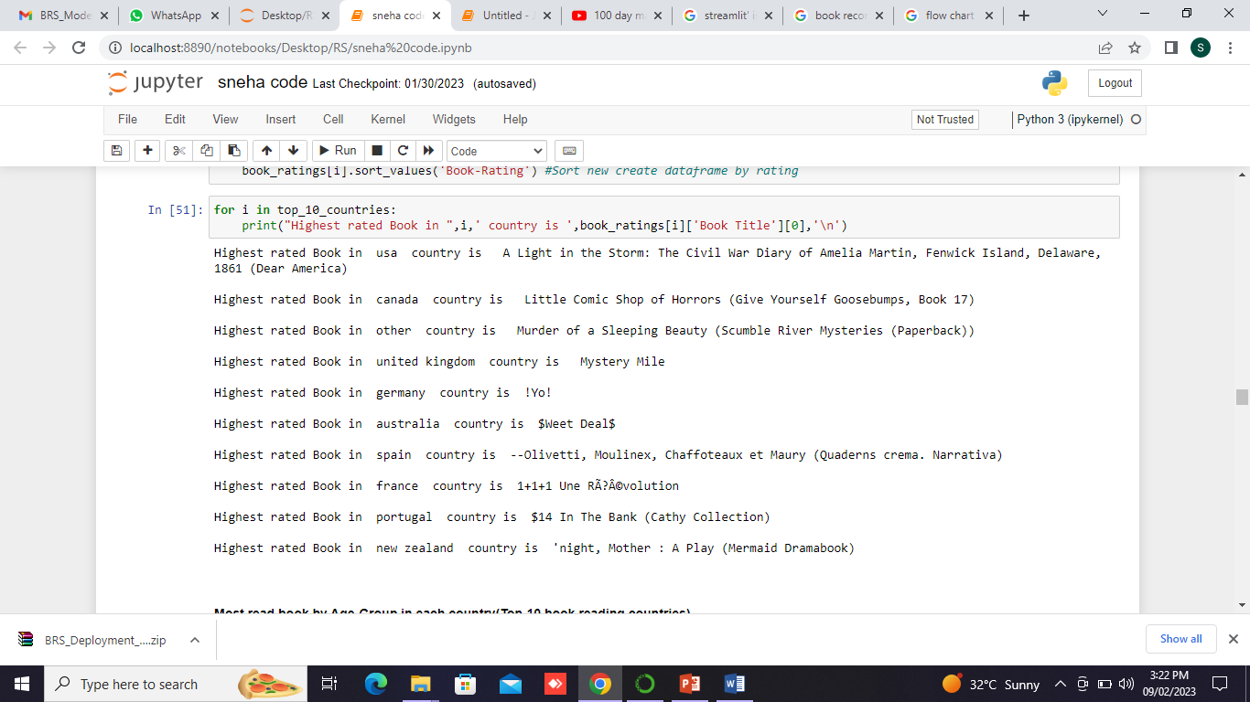
EDA & VISUALIZATION
2. Highest Rated Book Country Wise

Slide 9
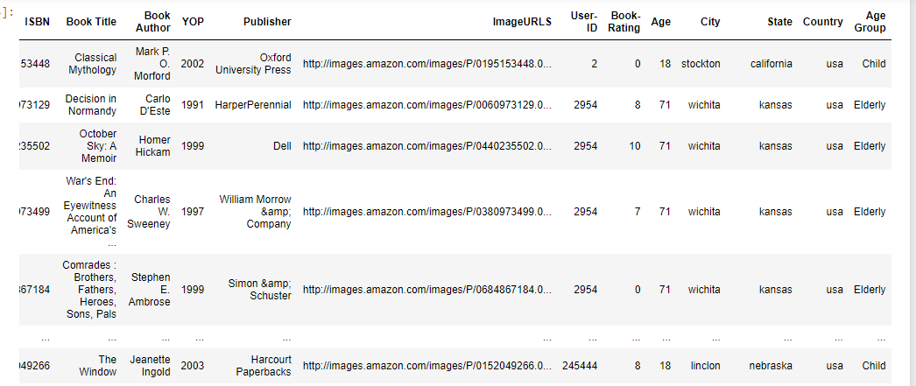
EDA & VISUALIZATION
3. Most read book by Age-Group in each country(Top-10 book reading countries)

Slide 10
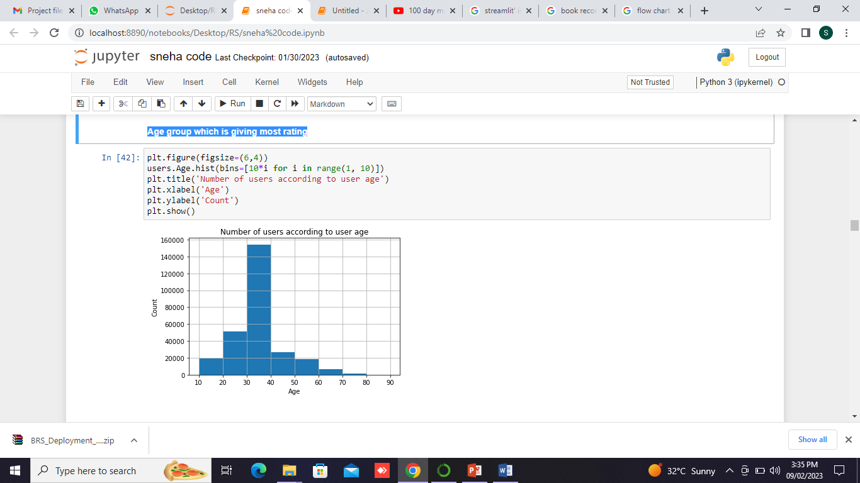
EDA & VISUALIZATION
4. Age group which is giving most rating – 30 to 40 yrs
Other Visualization are also plotted such as;
Top 10 authors who have written the most books.
Top 10 publisher
No of books published by a publisher (Top 15)
No of books by an author (Top 15)

Slide 11
HIGHLIGHTS ON EDA
Most books are read from the age group of 30-40.
92% of readers are from 15 countries (20% is from USA alone)
Most Read Book in Top-15 Countries is 'Wild Animus‘
Different Age-Group from USA, Canada, United Kingdom, Australia& Others(33% of total countries) have similar interest in book.
High Rated(Most liked) Book varied from country to country

Slide 12
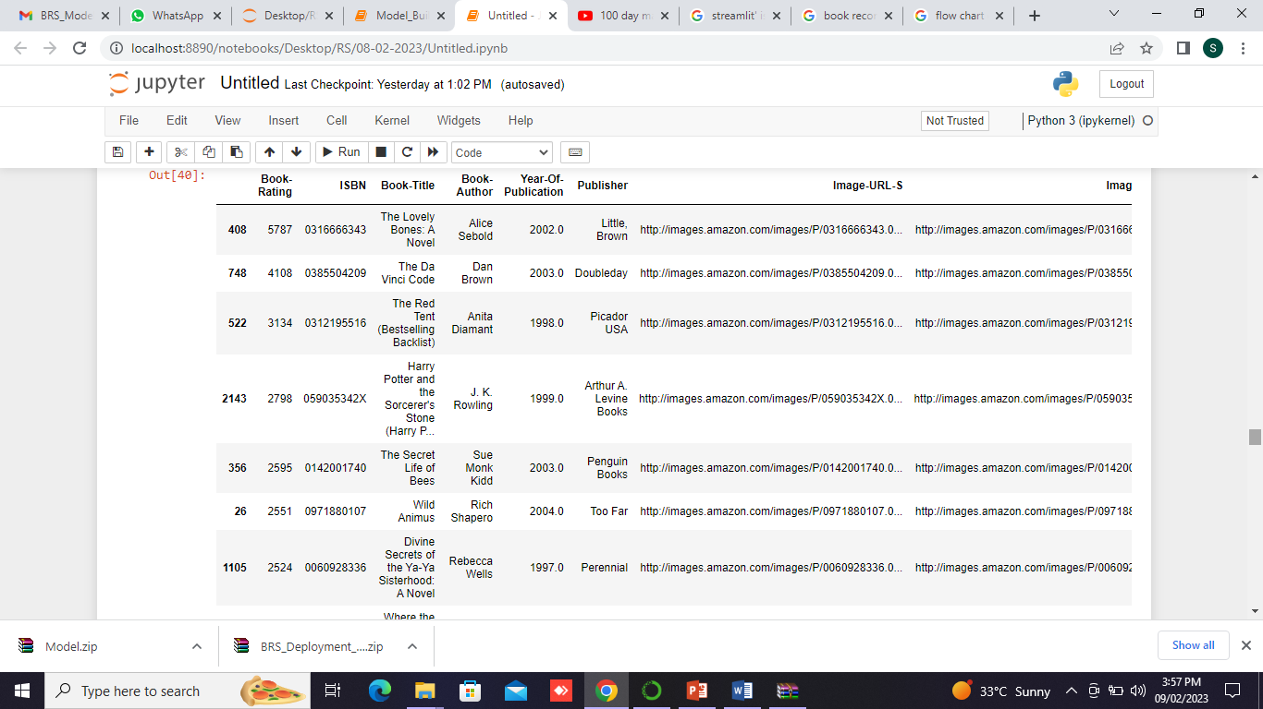
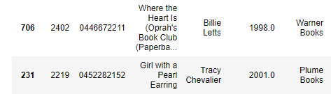
MODEL BUILDING
Popularity based Recommendation System - Based on the principle of simple popularity based recommendation, we have recommended the following top 10 book to users

Slide 13
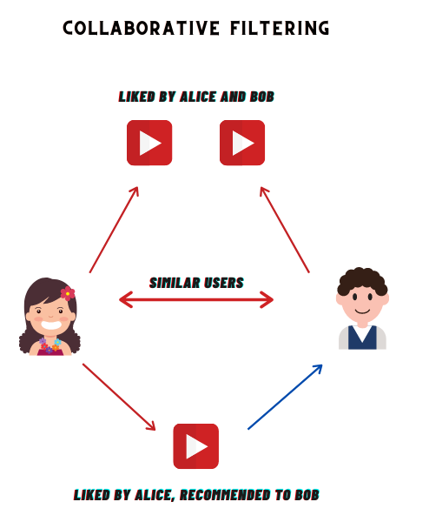
MODEL BUILDING BY COLLABERATIVE FILTERING

Slide 14
MODEL BUILDING
Collaborative Filtering (USER-USER) - We have built user-user model in this type since we will be recommending the books based on the input of user details/ids.
We have taken any random/target users & studied the similar users to the target one accordingly.
After this all the books read by target user & similar users are compared.
Criteria taken in this are for only those books which have received at least 20 ratings.

Slide 15
MODEL EVALUATION
We have evaluated the model as follows,
SN | Random User-ID | Similar User Ids | Total Books | Match Count | Accuracy
1 | 90391 | 233040,277517,147372, 95447,171610 | 10 | 6 | 60%
2 | 59269 | 11924,253119,95301,243214,230480 | 10 | 5 | 50%
3 | 169682 | 98887,35148,249405, 51647,88812 | 10 | 8 | 80%
4 | 35433 | 230427,35407,75115, 197392,64365 | 10 | 7 | 70%
5 | 105517 | 147420,17588,140223, 99077,74595 | 10 | 3 | 30%
6 | 75591 | 8529,95359,248821, 275305,261768 | 10 | 2 | 20%
 |  |  | Model Accuracy |  | 51%
Accuracy | = | No. of Common books between User and Recommendation List (Top10)
 |  | Top-10 Books by rating for given User

Slide 16
Model Deployment
After Model building & Evaluation process, we have deployed the code using “Stream lit”
We have selected the best model & used in our deployment phase.
DEPLOYMENT

Slide 17
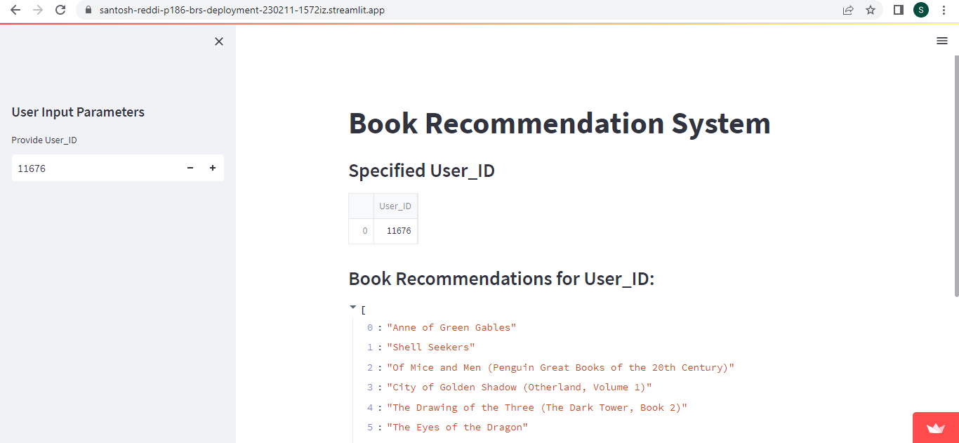
Model Deployment

